Slide 1
Proof of Concept Virtual World Workflow
Matlab to generate Noisy texture (filt2d is mxn convolution of 1s)
R = rand(1024)*255;
G = filt2d(rand(1024),'avg',50,50);G = G - min(G(:));G = G * 255/max(G(:));
B = filt2d(rand(1024),'avg',150,150);B = B - min(B(:));B = B * 255/max(B(:));
RGB(:,:,1)= R;RGB(:,:,2)= G;RGB(:,:,3)= B;
imwrite(uint8(RGB),'test.png');
Blender to manually generate scene
101 640x480 pixel images along a path at 15m elevation (exact X,Y,Z positions unknown)
13 GCPs, nine at Z = 0.125m, four at Z = 5m
Ground plane at 0
Random basic shapes, random sizes, shading “on” from 4 light sources
CloudCompare to do a points to mesh difference
Used Dense Photoscan Output using all GCPs

Slide 2
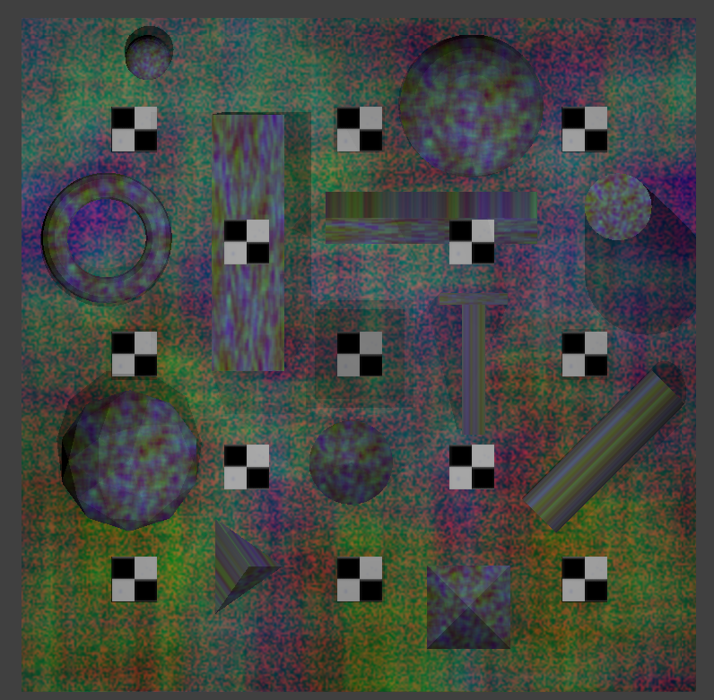
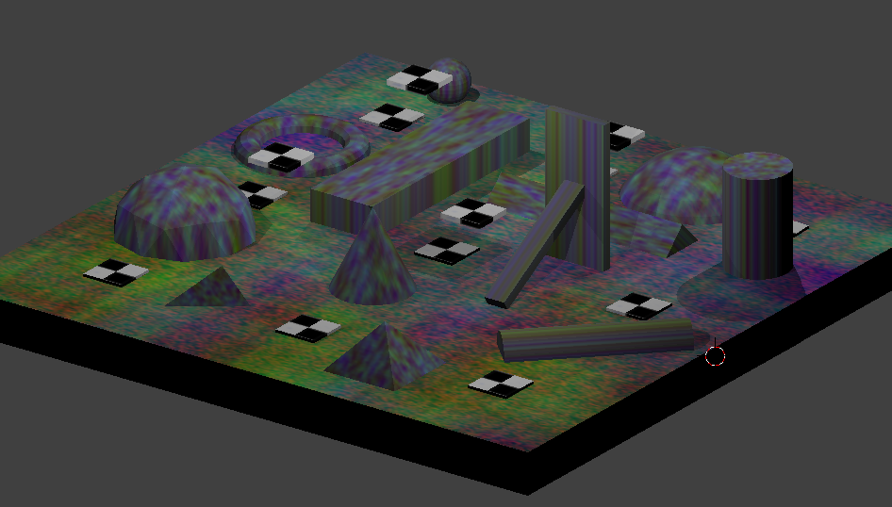
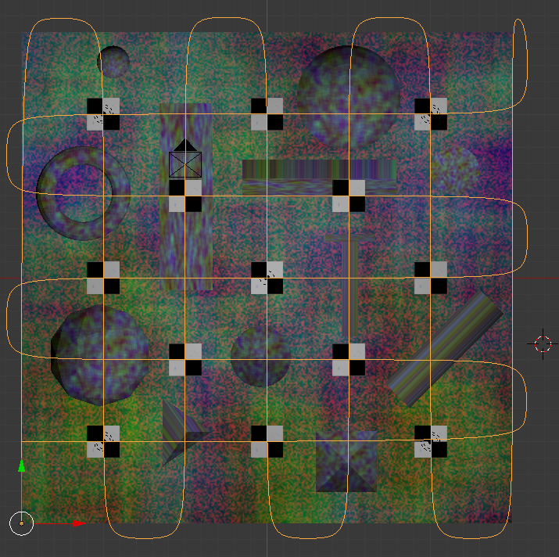
Blender
25m x 25m
Pyramids
Cones
Cylinders
Rectangular prisms
Spheres
Donuts
etc
FLIGHT PATH

Slide 3
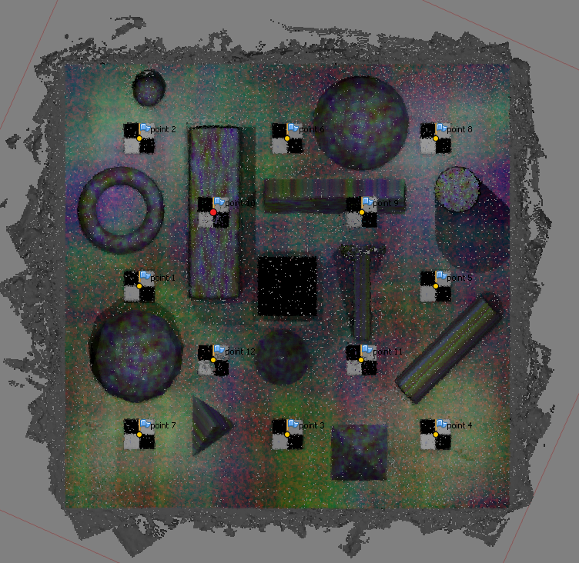
Photoscan
Black Hole in middle was due to a rendering issue in the imagery, but photoscan actually tried to make points to put there even when there was no texture at all.

Slide 4
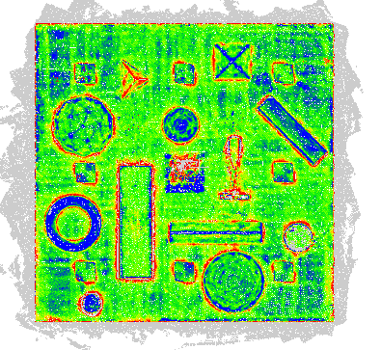
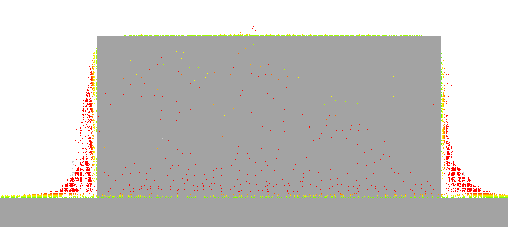
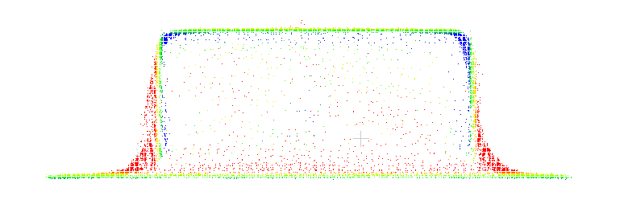
CloudCompare
25m x 25m
Caxis = [-0.05 0.05]
Photoscan
ERRORS!

Slide 5
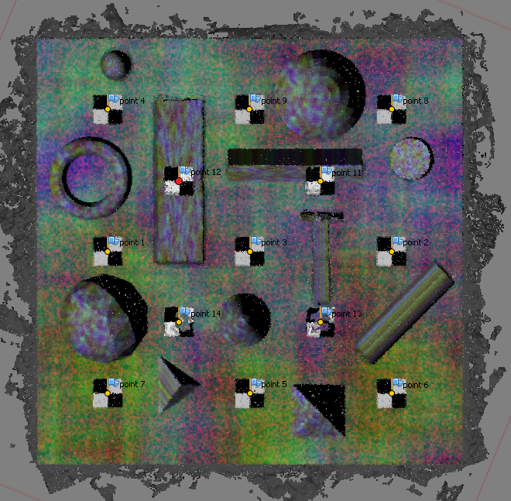
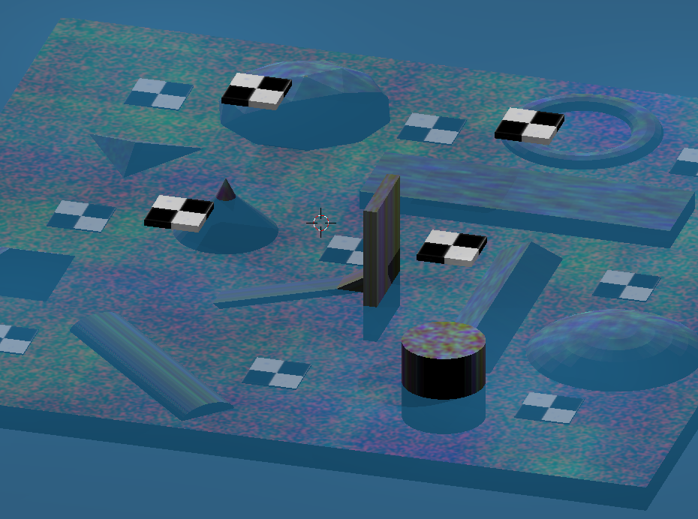
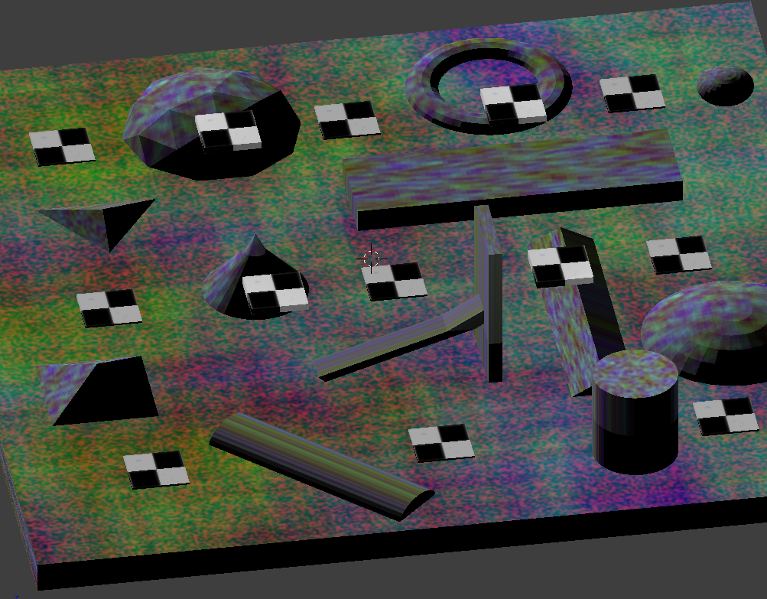
Photoscan
3 meters flat water
Colored blue just for this figure
Shadows due to output rending from blender. No texture in raw imagery.
Some structures half in water

Slide 6
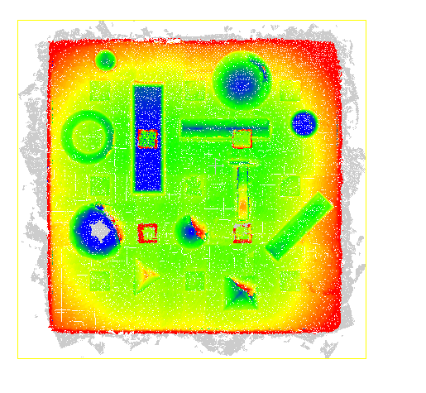
CloudCompare
3 meters flat water
Refraction 1.33
*fixed focal length with truth
caxis = [-0.4 0.4]
BIG ERRORS!

Slide 7
With 3 meters water vs with no water
caxis = [-0.4 0.4]
caxis = [-0.05 0.05]

Slide 8
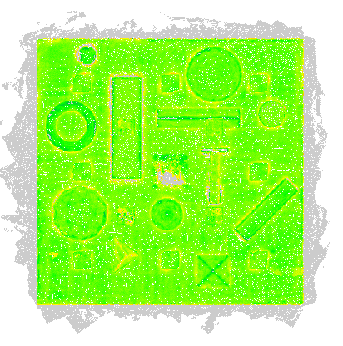
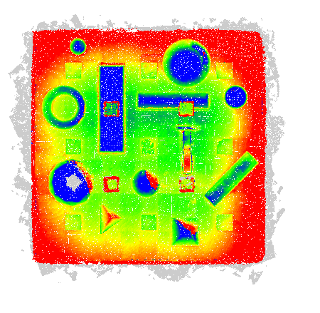
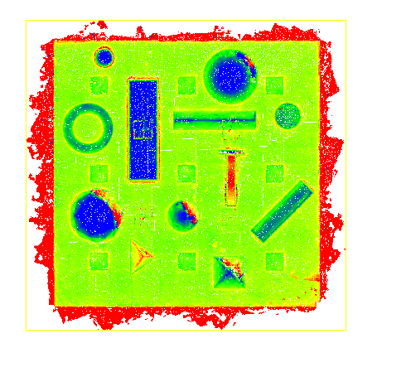
caxis = [-0.2 0.2]
No Water
Intrinsic Float
Water
Intrinsic Fixed
Water
Intrinsic Float

Slide 9
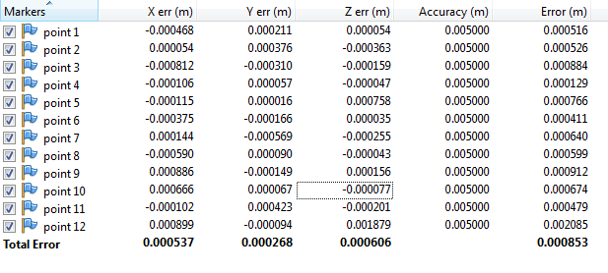
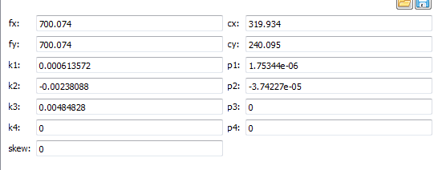
Extra: Photoscan Results
GCPs
Intrinsics
(all GCPS used in adjustment)
Actual Values
700
700
0
0
0
0
0
320
240
0
0
0
0
~49 degree FOV Nadir at 15m altitude
5 meters between horizontal lines
Flew Cross hatch pattern (N-S, and E-W)

Slide 10
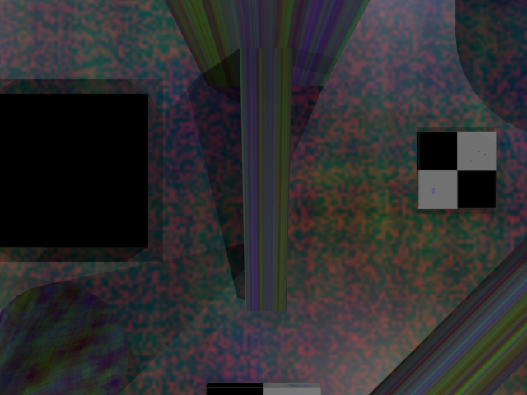
Problem with other way we talked about
If the cameras have accurate poses, we’ll get great agreement on where the point should be in pixel space
But the resultant pointcloud won’t have a high accuracy here!

Slide 11
Problem with other way we talked about
And since we already know camera poses from Blender, we can just calculate the camera pose errors directly
To better quantify accuracy, we should look at the matches the software used
*I have mixed feelings about diving into the photoscan matching output, on one hand I want this methodology to be software agnostic, but on the other hand I want to know what photoscan is doing. We could probably utilize this, or a similar, methodology on any other software that outputs camera poses though
error
error
truth
truth
calculated
calculated

Slide 12
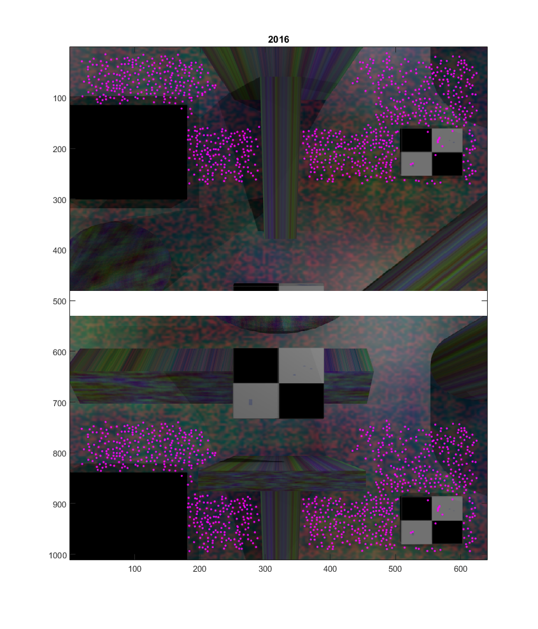
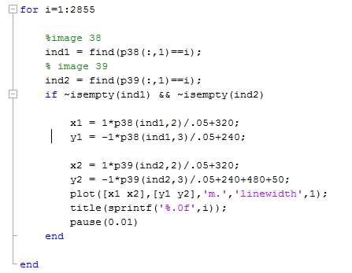
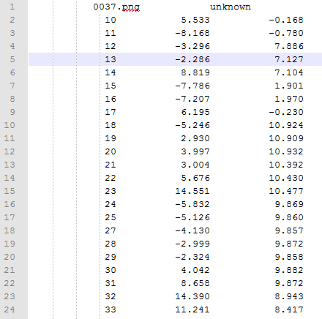
Exported matches from Photoscan
Matlab to decode matches
dat file
filename
Keypoint id x pixel ypixel

Slide 13
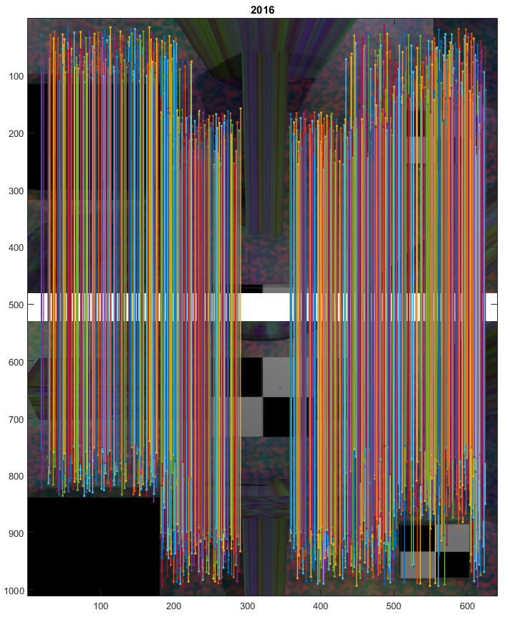
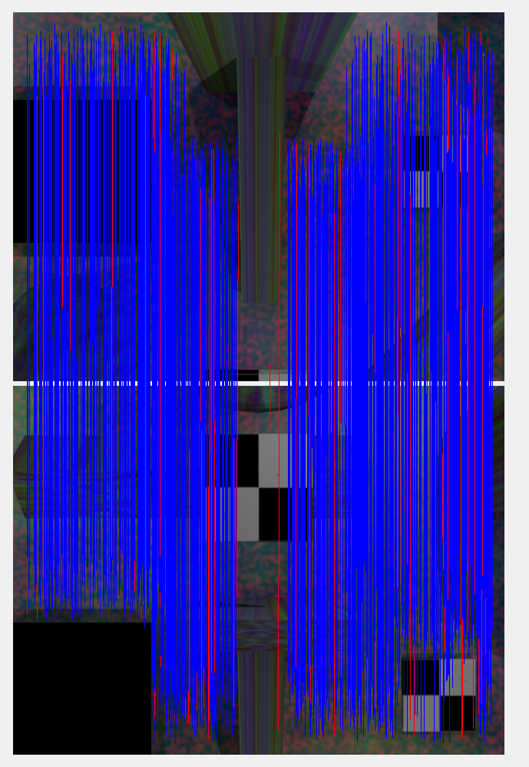
Visual validation of my Matlab code Photoscan(left) Matlab(right)

Slide 14
Relative Accuracy
Least Squares to find point of intersection and standard deviation of XYZ points
Low Accuracy
High Accuracy

Slide 15
Do this to all the points using the matches in Matlab
Now for each coordinate export:
Std(X)
Std(Y)
Std(Z)
Or some type of covariance
Then Validate this predicted error with actual

Slide 16
Relative/Absolute Accuracy
Previously described method gives “relative” accuracy
To quantify absolute, we need:
How well is an image mapped to a GCP?
How well have images been mapped as we get away from GCPs?
Need to quantify an uncertainty metric for how well two images are mapped to each other
How many points in each image are matched?
How well are points in each image matched to each other?
Are other images matching too?
Uncertainty between images should be an uncertainty in rotation and translation
We can then propagate those errors to farther away images
Once we have an uncertainty for our camera orientation, we can propagate that error through in combination with the relative accuracy to get a total error estimate

Slide 17
Absolute Accuracy
Degrades farther from GCPs, and quickly if poor matching between images
H
B
A
G
C
D
F
E

Slide 18
SFM Sensitivity from VDOS Flights
Higher Altitude degraded much quicker than lower altitude, despite being fewer images away.
So my hypothesis was that the accuracy of matches between images was worse than that at lower altitudes. (flip between slides to see)

Slide 19
Once Absolute Accuracy Calculated
Can we now perform a weighted least squares for relative depth?
Point at magenta star is seen in D and E
Should we weight D more heavily?
B
A
C
D
E

Slide 20
Relative Accuracy Weighting based on orientation accuracy
Is this iterative? Or redundant?
Because absolute accuracy is calculated based on this first least squares matching
Could also develop a confidence for where the keypoint is in the image, and weight points near edge of images(higher distortion) lower
Weighted higher for green image keypoint matches

Slide 21
todo
Lit Review
How to make robust, noisy texture for keypoint matching?
How to calculate relative and absolute accuracy of pointcloud?
How to calculate cloud to mesh distance calculations?
What traditional cameras and flight patterns used in SFM accuracy tests?
Overlap, sidelap, focal length, etc
How have others quantified error in SFM pointclouds?
Other pointcloud calibration test scenes (What shapes do other people use?)
Better Understand Blender
Python scripting
Texture mapping
Accurate, (explicit) camera placement (not just follow path)
Test Blender agorithms to make sure accurate images being made

Slide 22
Todo (cont)
Layout all the potential experiments
There’s a ton
Select a good first experiment
Layout first test scene to achieve first experiment
Layout on paper different shapes, sizes, textures, etc

